Slide 1
Bismillahir rahmanir rahim
Welcome to MBSTU online semester final examination registration and credit fee payment system
Developed by:
Md. Faruk Hosen
Md. Nayon Ali
Md. Rafatul Haque
Md. Nazmul Hasan

Slide 2
Background
When I was at first semester I saw students pays their credit fee to the bank by standing outside of the bank in a queue system which is an analog way. Because of this system we miss our classes sometime.
As a student of ICT department I felt to do something in a digital way which would solve this queue system .
At the beginning of this semester we came to know that we have a software development course, then we (our four team member) thought to develop a software to pay our credit fee in a digital way. Our honorable course teacher (Nazrul Islam Sir) was pleased to hear our IDEA and he encouraged and helped us to make this IDEA into a software.
At the end we want to say thanks to our supervisor Mr. Nazrul Islam Sir for his cordial support

Slide 3
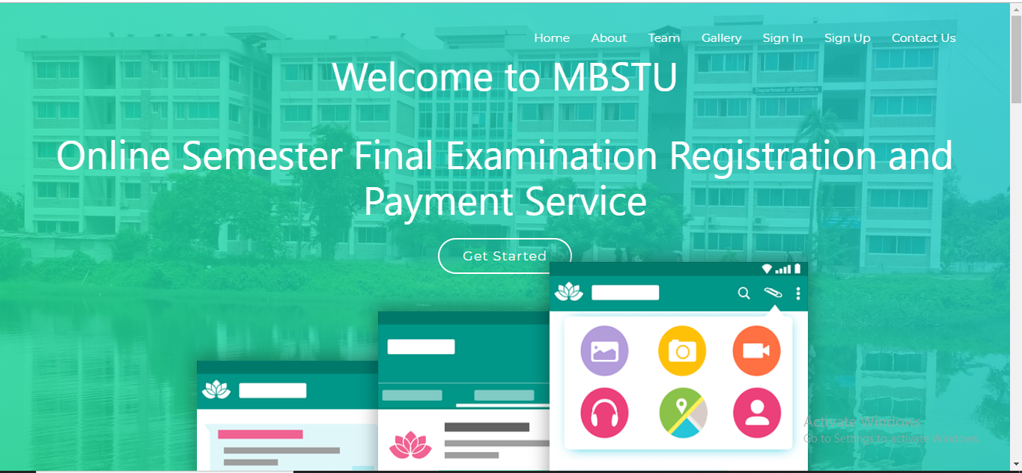
When a user visit into our site. He/she will see the following page like this:

Slide 4
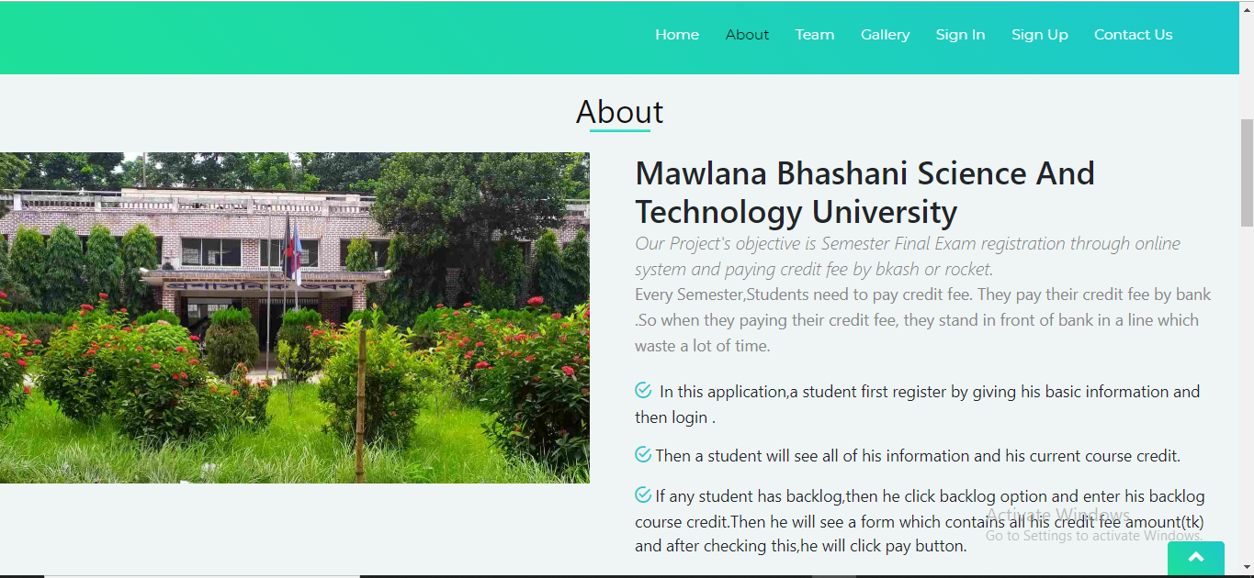
When a user click on About on the navigation bar. He/she will learn about our project :

Slide 5
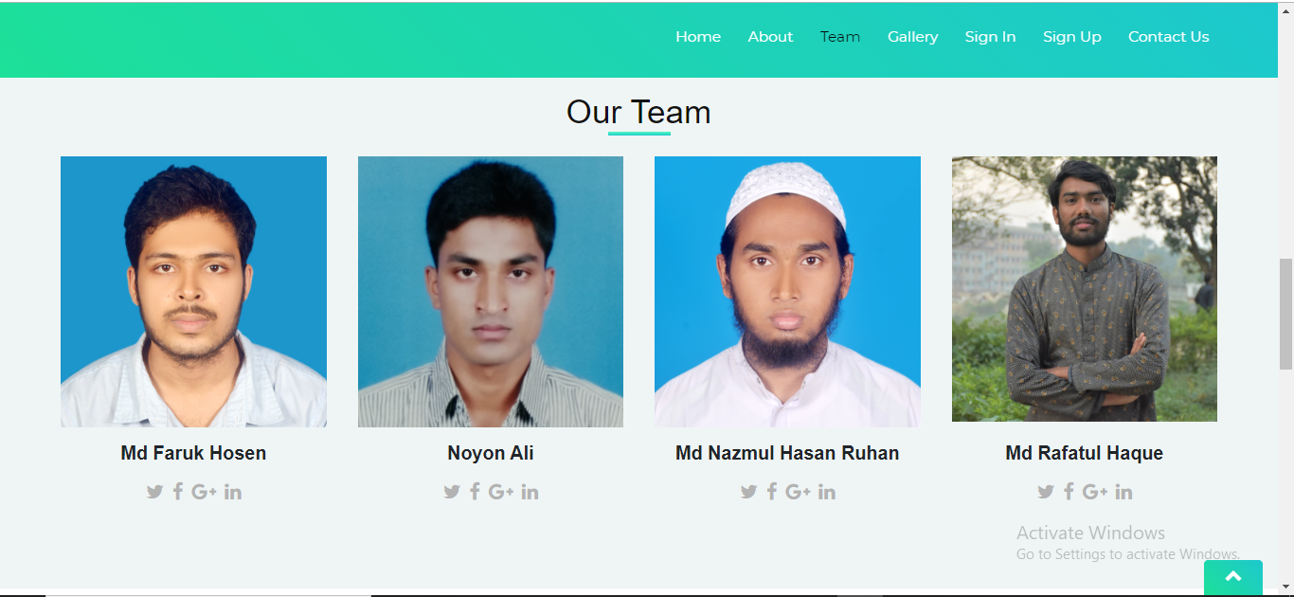
When a user click on Our Team on the navigation bar. He/she will know about our team members:

Slide 6
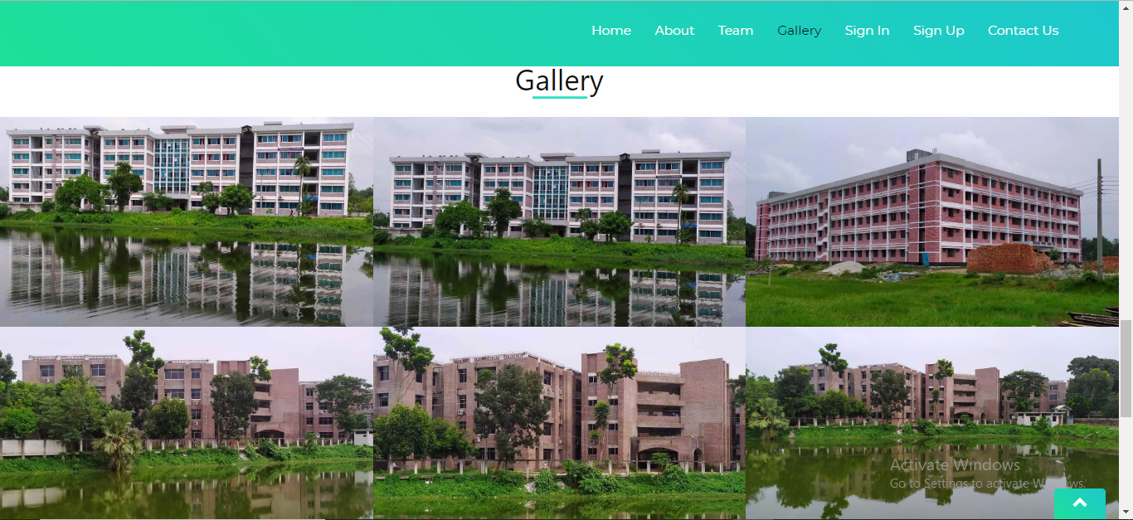
When a user click on Gallery on the navigation bar. He/she will see some photos of our university:

Slide 7
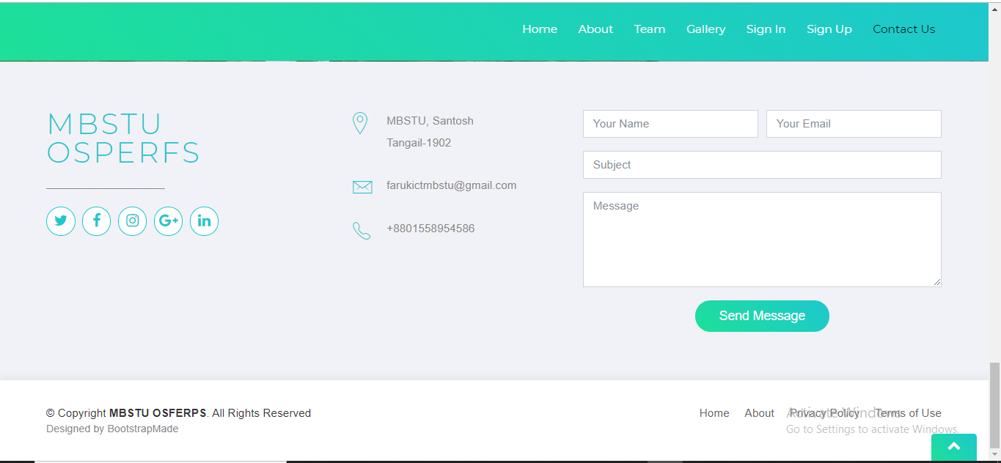
If any user will want to contact with us, he/she can click on Contact Us on the navigation bar. He/she can send any comment or message to us :

Slide 8
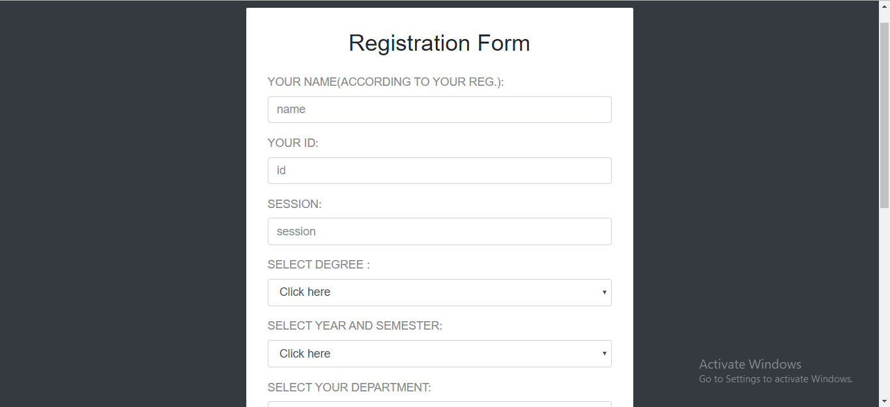
First of all, a student should sign up to this application. After completing the registration form, he must click on the register button.

Slide 9
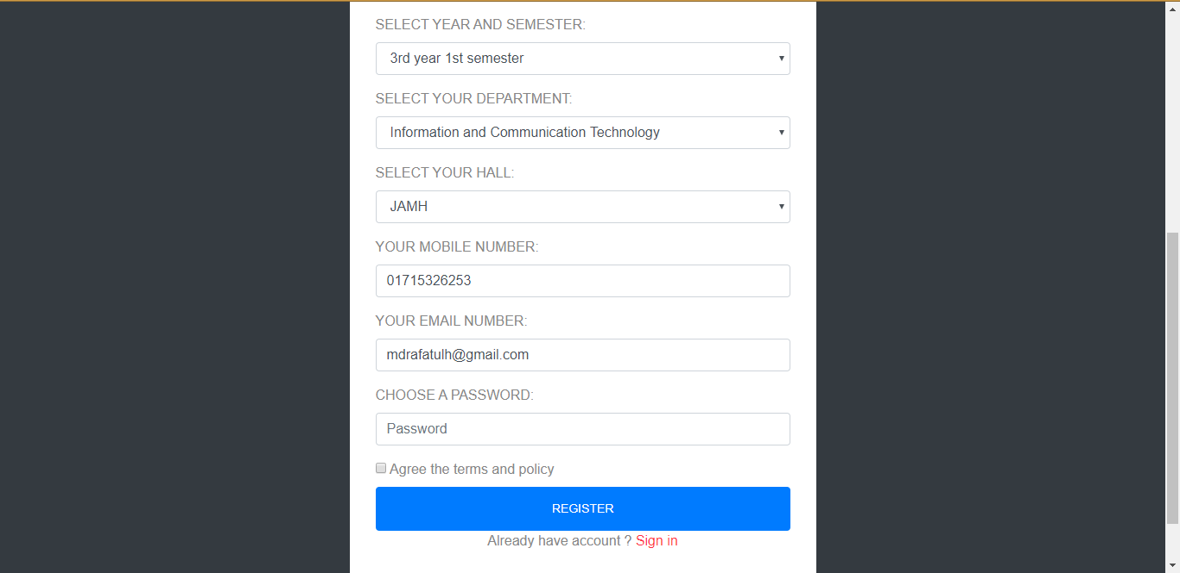
For example, a student (Md. Rafatul Haque) and his email id email: mdrafatulh@gmil.com. After clicking on register button a mail will send to his email id and it will redirect to login page.

Slide 10
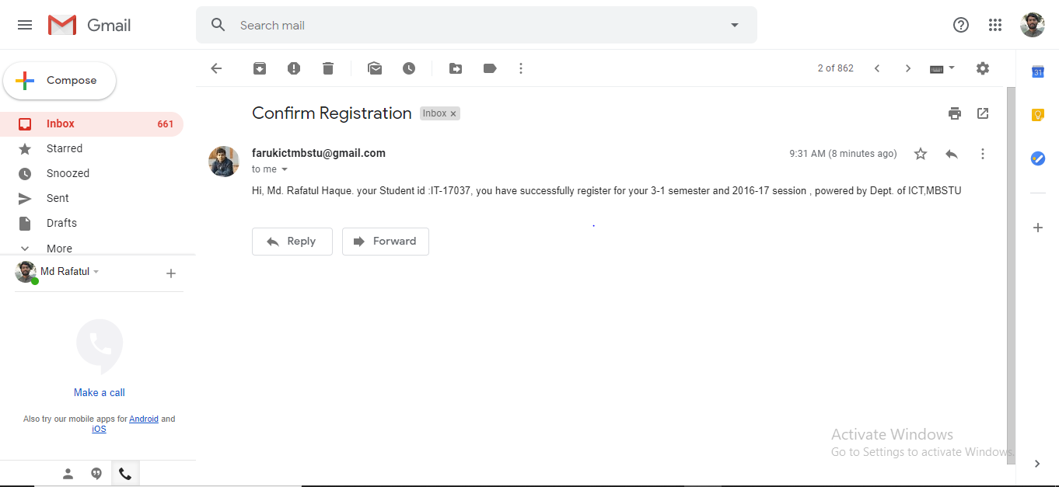
This is the confirm registration mail from this application to Md. Rafatul Haque.

Slide 11
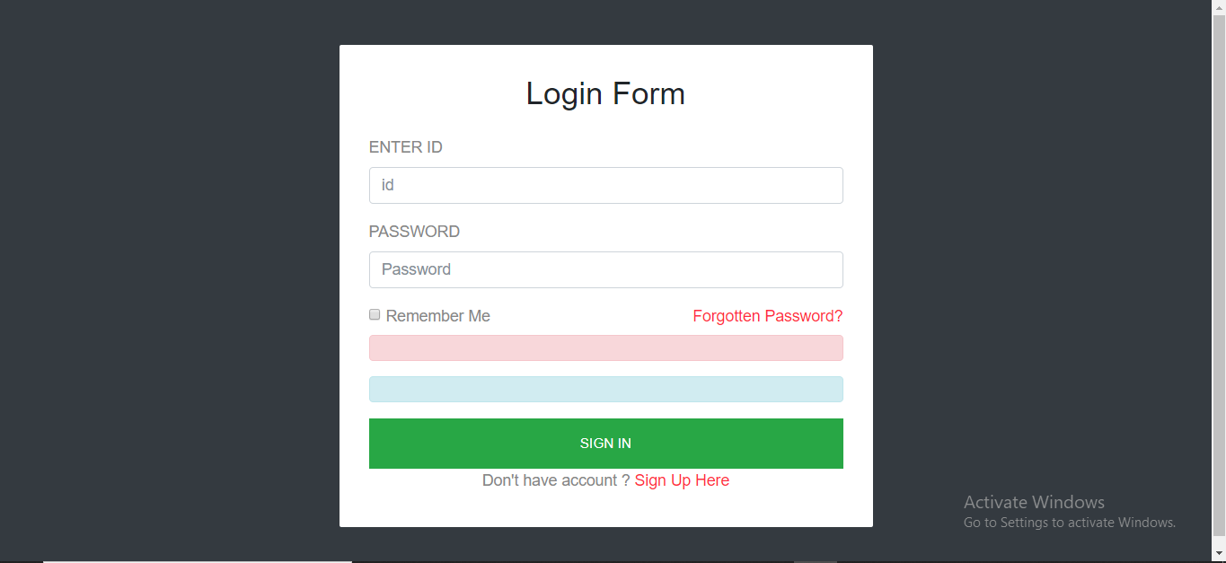
Then the application will show login page. Now a student should sign in with his valid ID and password.

Slide 12
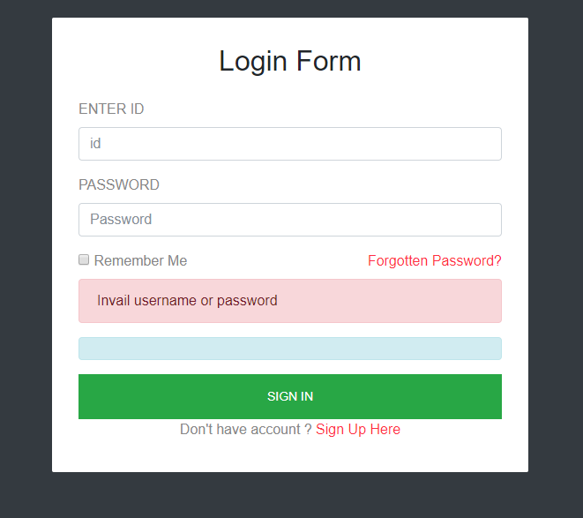
If the user id or password of the student is not valid then the login page will redirect with the following message.

Slide 13
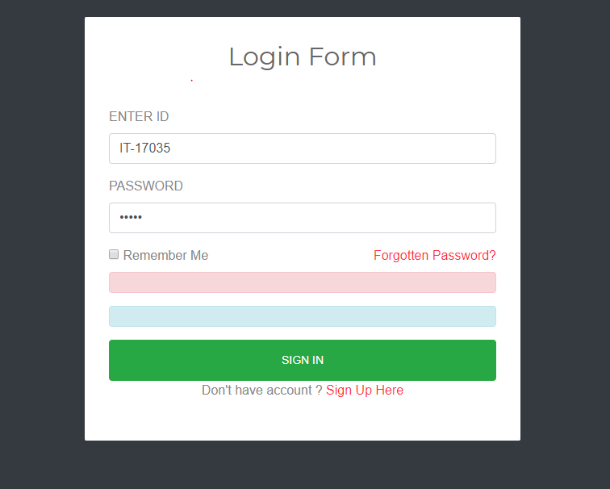
For example, a student(Md. Faruk Hosen) who was previously registered to this application and sign in with his ID and password.

Slide 14
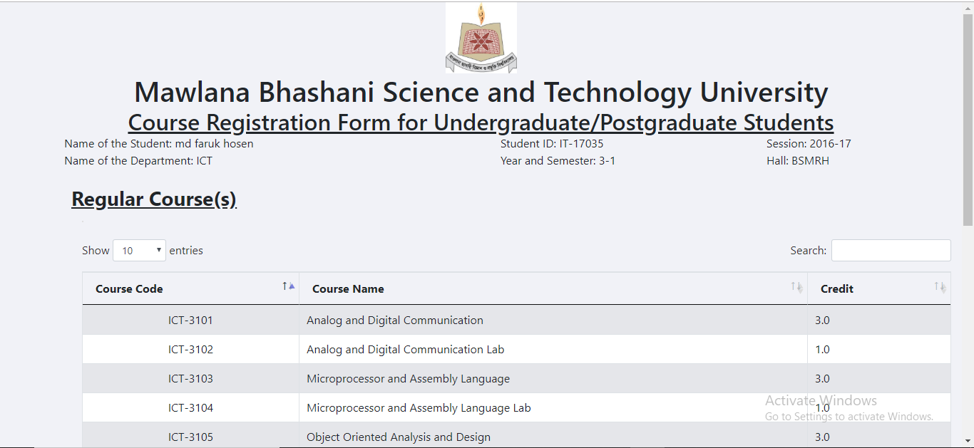
Then it will show the course registration page with his information like name, id, session, dept. name, year and semester, hall and his regular course information from database.

Slide 15
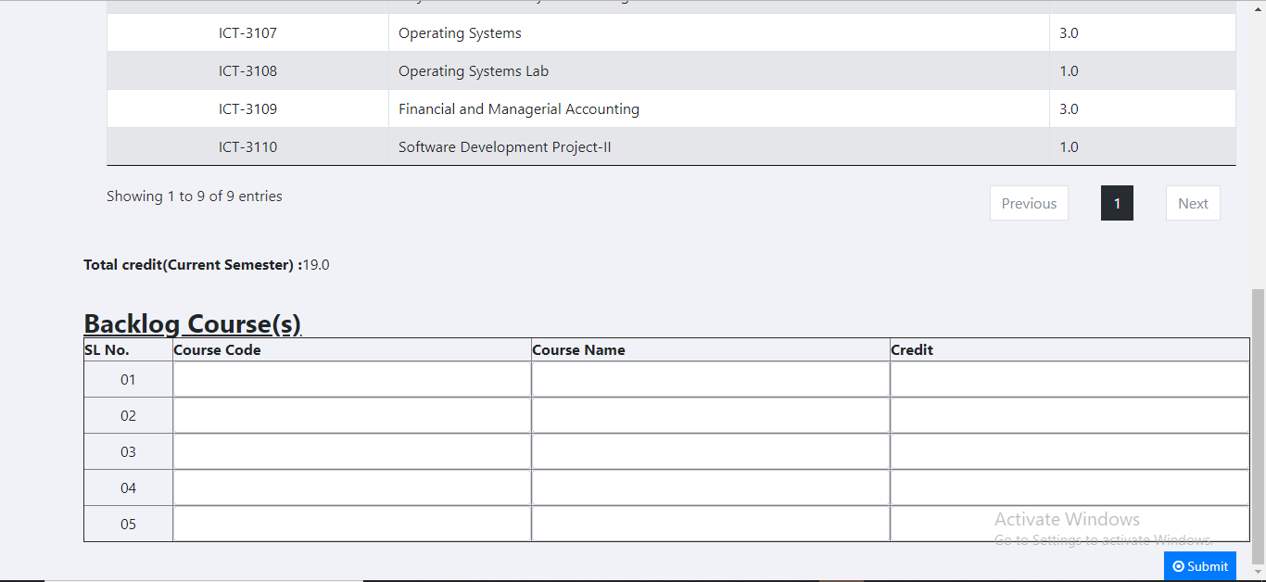
In bottom of the course registration page there is backlog course form. If the student has any backlog of previous semester, he should fill up this section. Then he/she must click on the submit button.

Slide 16
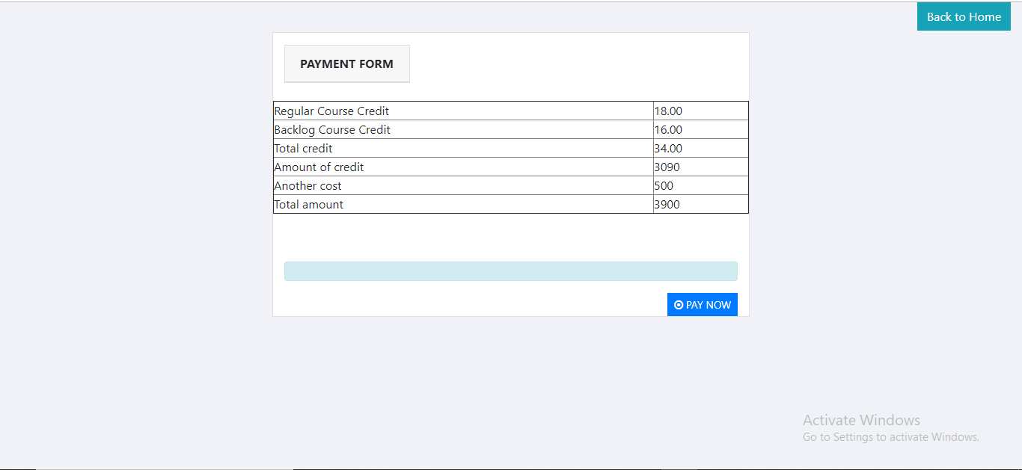
After clicking on the submit button, then it will show the following page with his payment information.

Slide 17
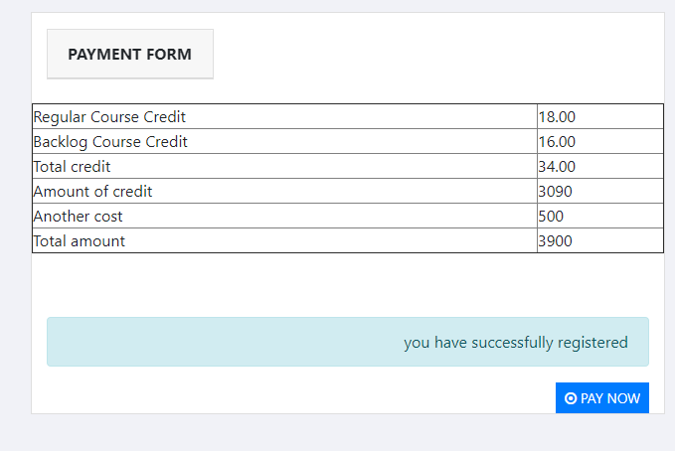
When the student click on the pay now button, then it will redirect this page with following message and send a confirmation payment mail to his email id.

Slide 18
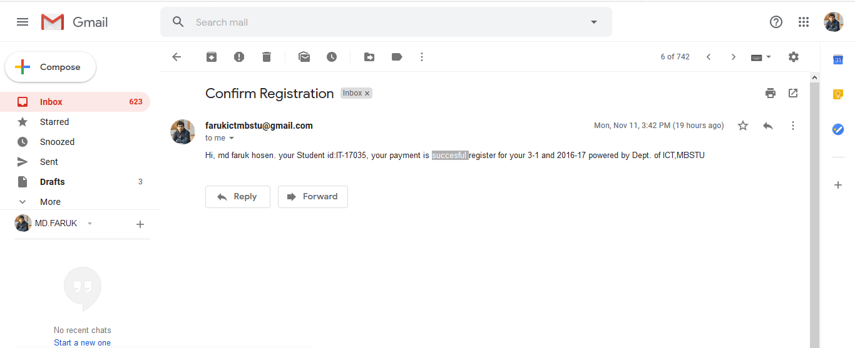
This is the confirmation payment mail sent from the application automatically.

Slide 19
Appendix of this project:
Frontend Code: | Html, css, javascript, jsp, Bootstrap theme.
Backend Code: | Java, servlet.

Slide 20
Group Members Activity:
Md. Faruk Hosen IT-17035 (Team Lead) | Give the concept to build this project. Design and Program the backend code. Work with some frontend code.
Md. Nazmul Hasan IT-17005 | Associate of Faruk with his concept for this project. Add the theme and customize it for this project. And work with some backend code.
Md. Nayon Ali IT-16062 | Associate of Faruk with his concept for this project. Help to meet with our immediate senior brother Mamun vai who help us to fix some bug in our project. And work with some frontend code.
Md. Rafatul Haque IT-17037 | Associate of Faruk with his concept for this project. He design the database for this project. And work with some frontend and backend code with Faruk and Nazmul.

Slide 21
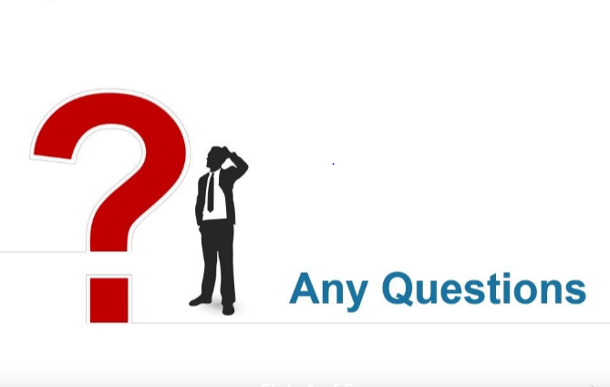
Thanks for watching

